Slide 1


By: Thabet Aljbreen, Abdulmuhsin Alanazi, Naif AL- Sabhan, Mohammed AL-Deaiji

Slide 2
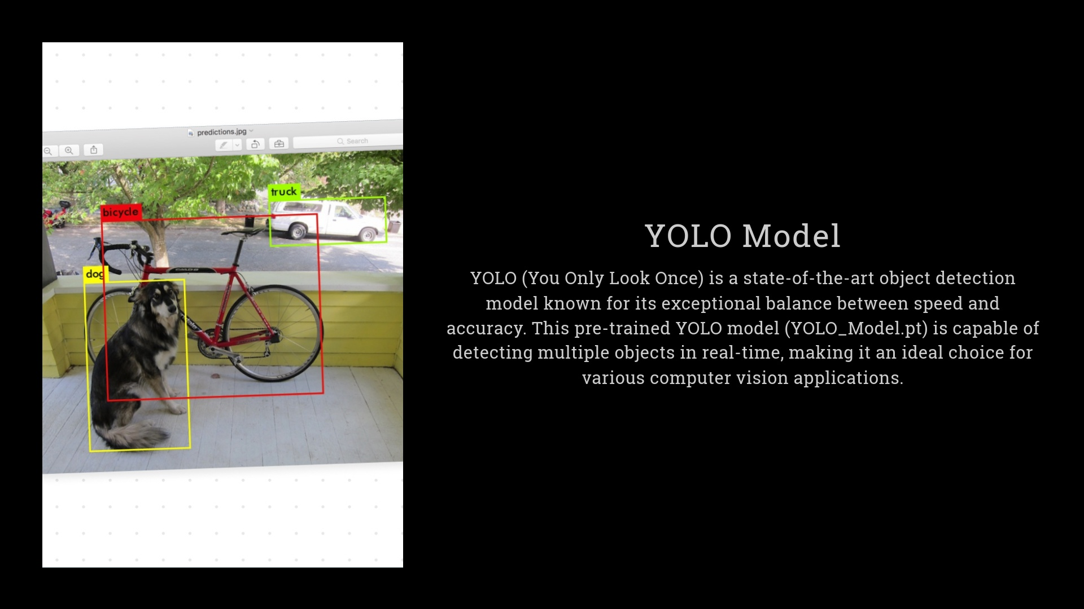
Time Counter for vehicles
Detecting each vehicle as an object
Label the Object with Bounding Box
Counting time for each object in the video

Slide 3
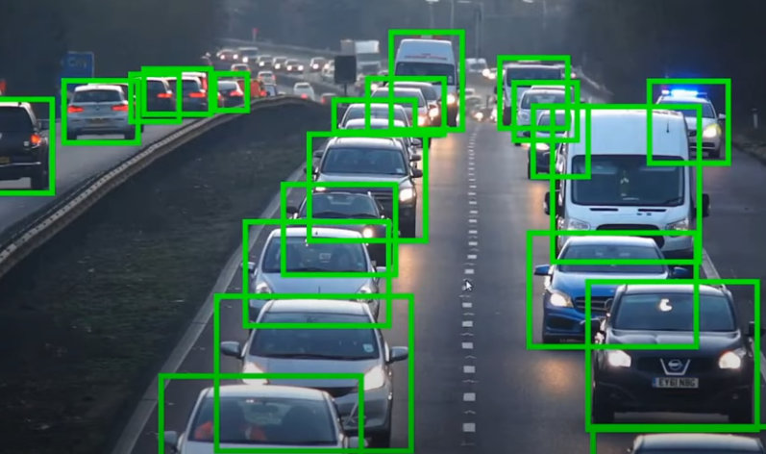
Sample of data

Slide 4
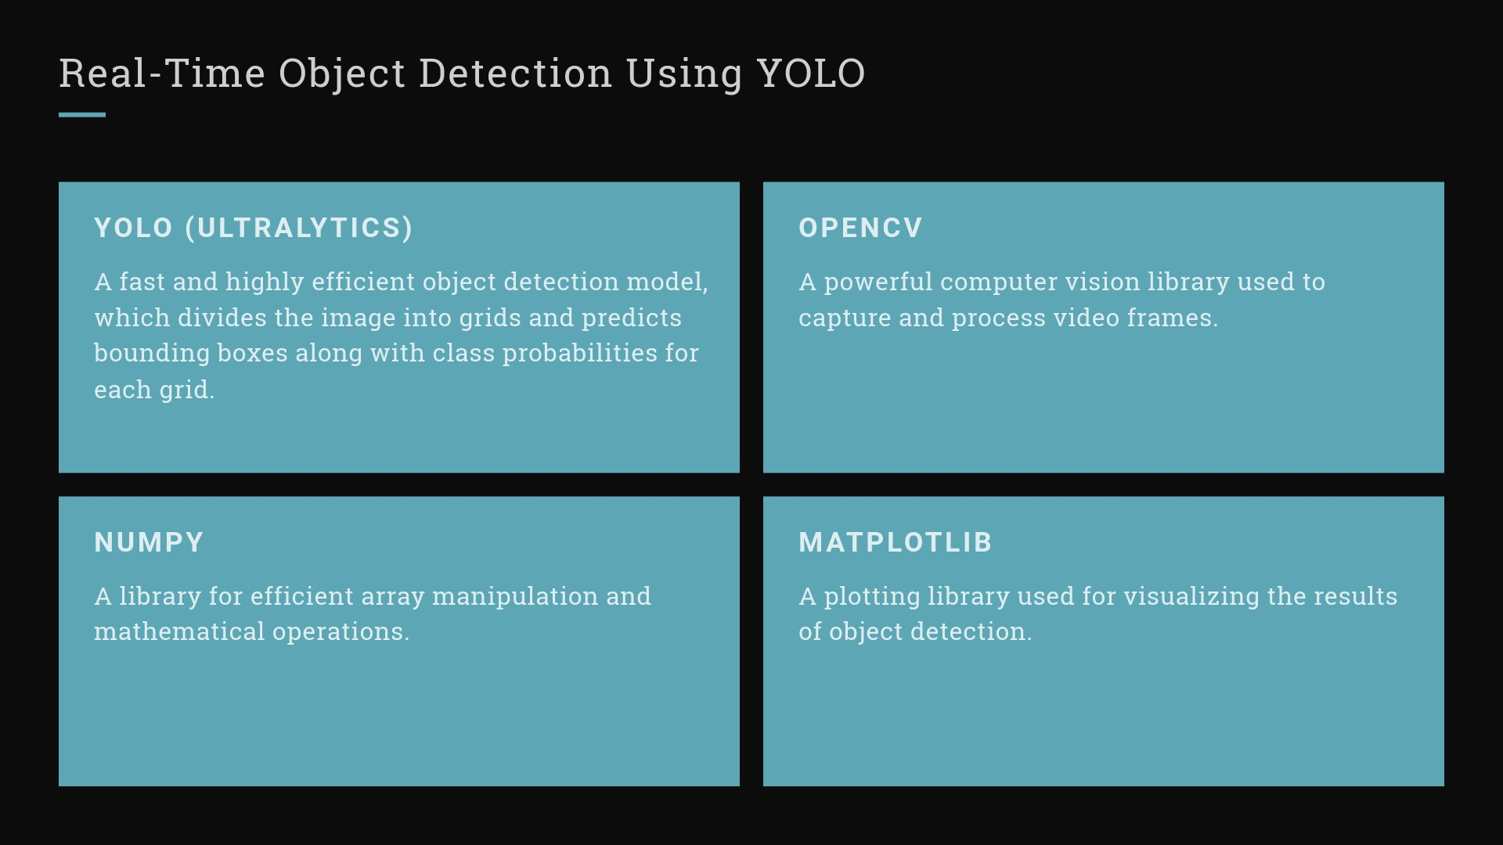

Slide 5
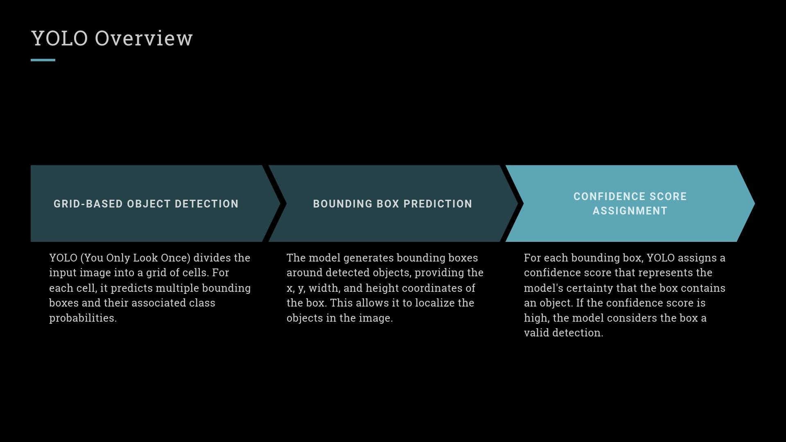

Slide 6
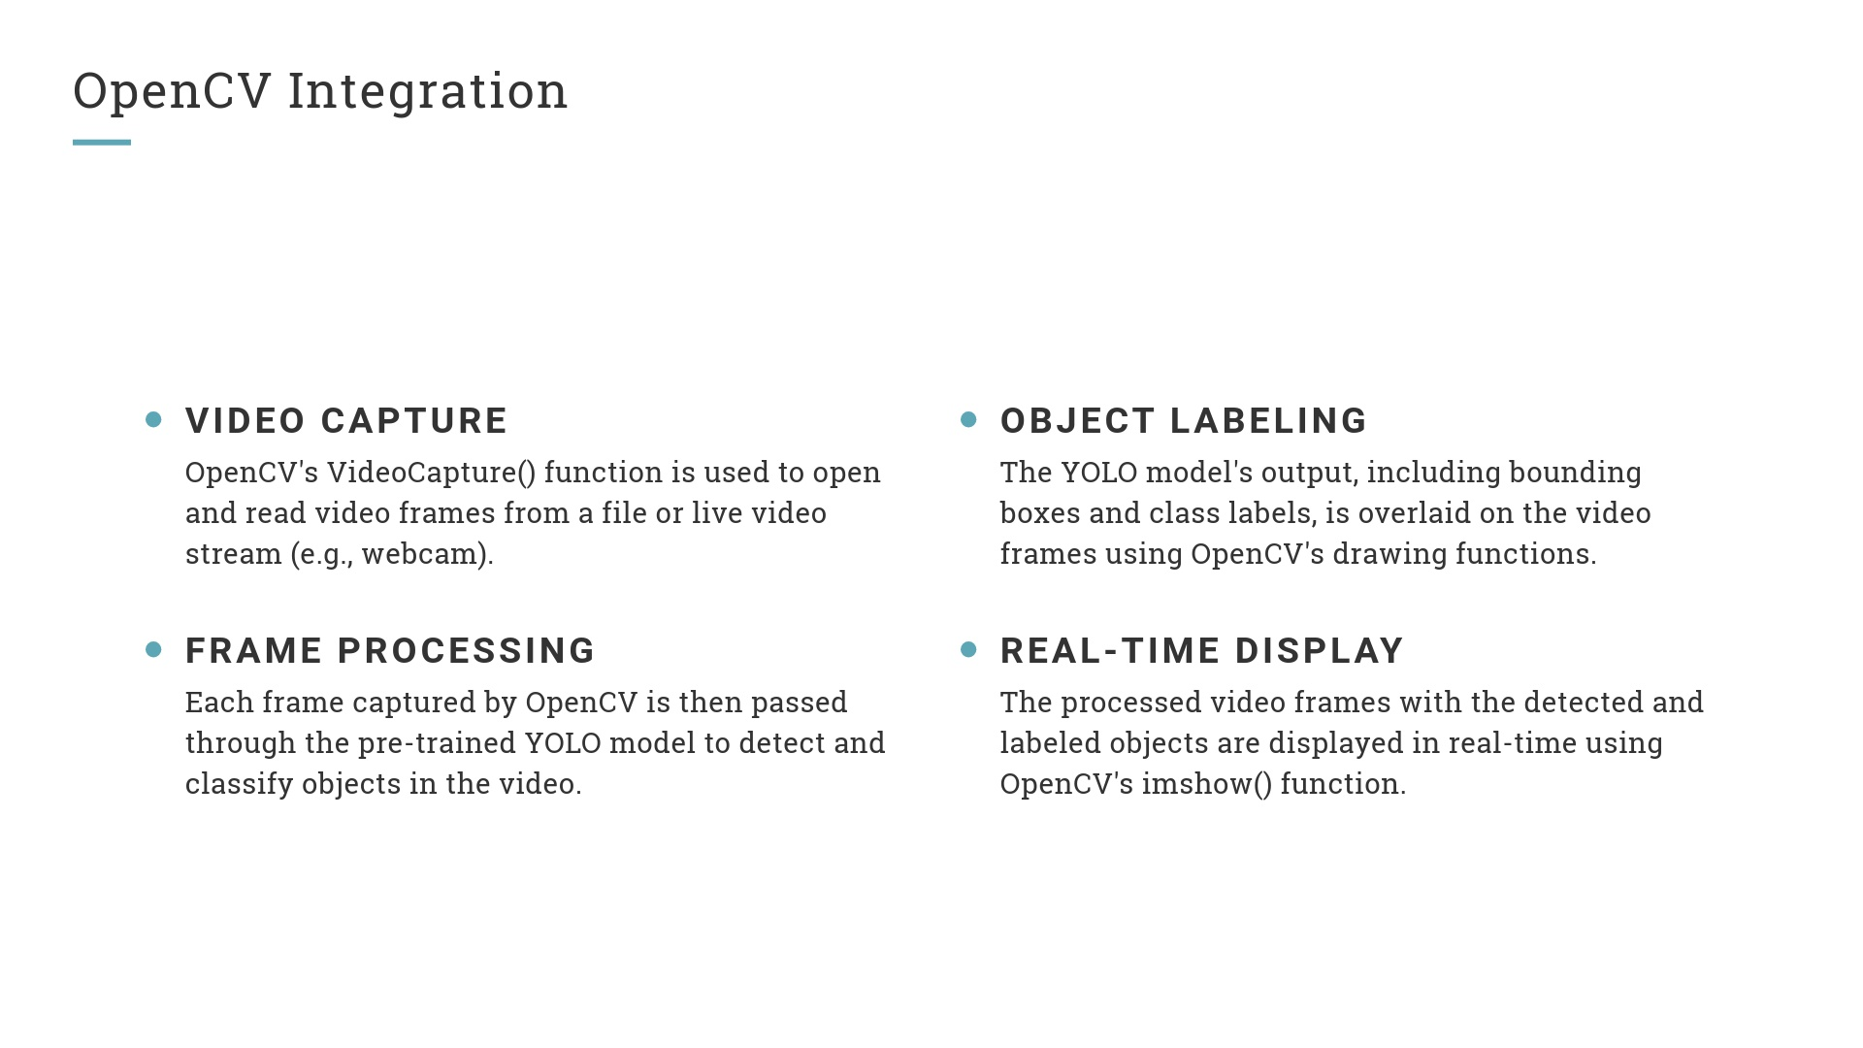

Slide 7
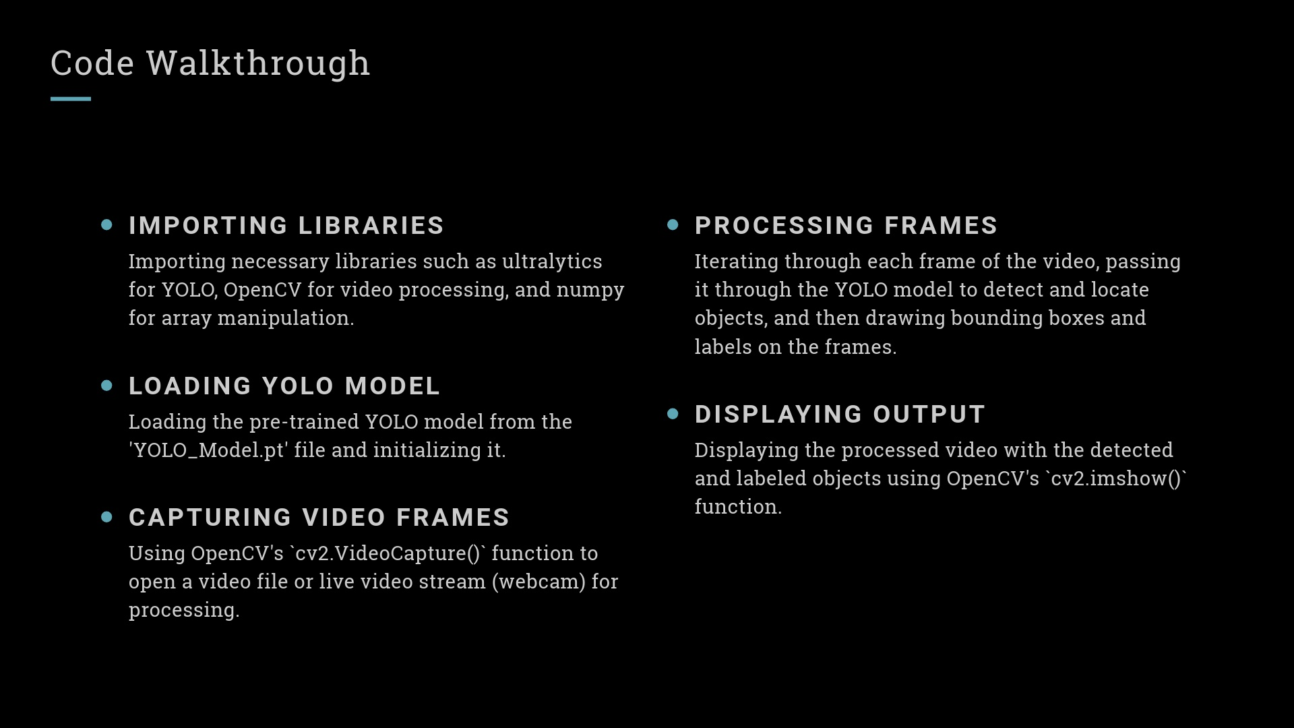

Slide 8
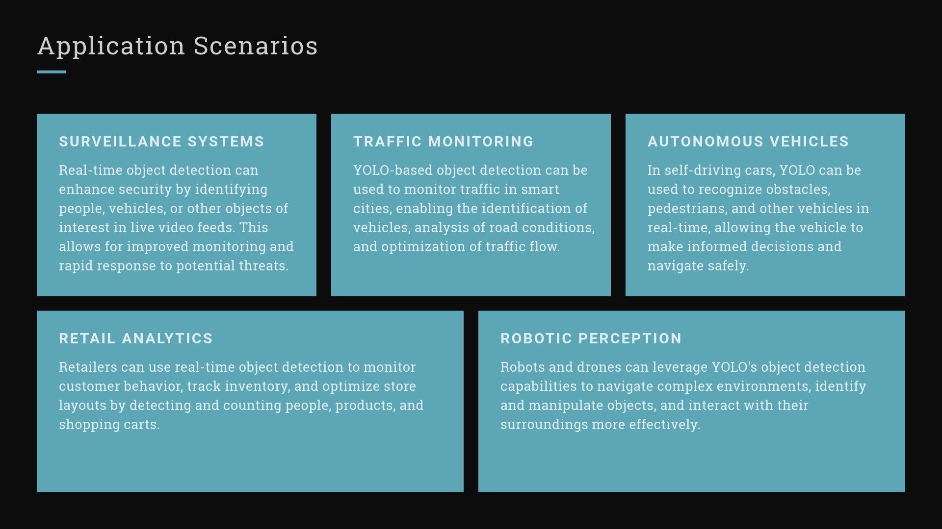
Application for our project:
Parking
Drop of Areas

Slide 9
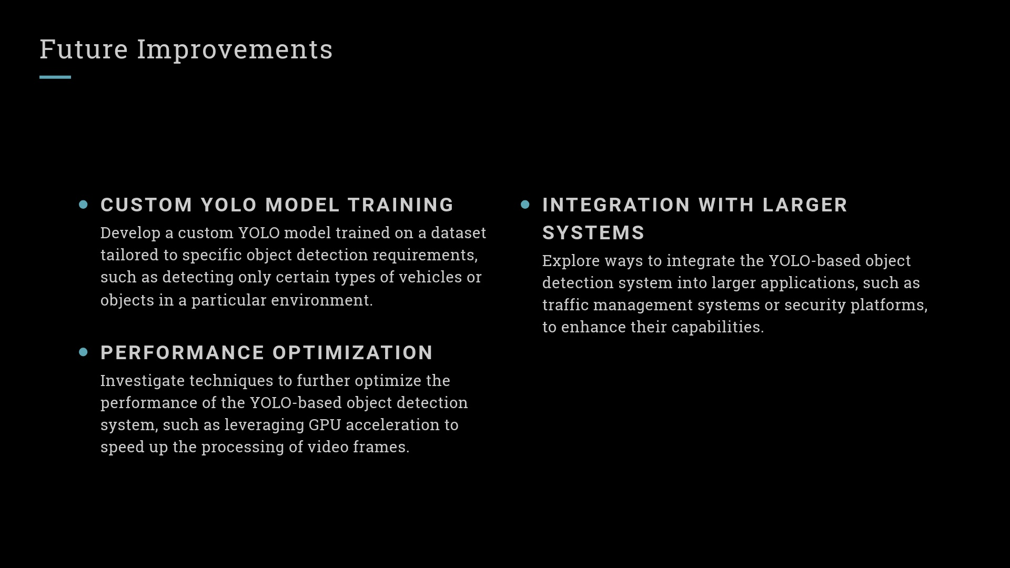

Slide 10
Thank you for your time

